Slide 1

Functional Writing
Functional writing equips students with the essential skills to produce documents required in academic and professional life — including formal letters, CVs, reports, business plans, and meeting minutes. This chapter covers the purpose, structure, and best practices for each document type.
CHAPTER ELEVEN

Slide 2
Formal Letters: Structure & Components
Formal letters (also called official or business letters) fulfill official functions — applying for jobs, requesting permission, apologizing, etc. Key structural elements:
1
Writer's Address & Date
Address top-right; date one line below.
2
Addressee's Details
Left side: title, name, workplace, and address (at least three lines).
3
Salutation
Two lines below addressee's address: "Dear Sir," "Dear Madam," "Dear Mr.…," etc.
4
Subject Line
Two lines below salutation: "REF:" in left margin; subject in capital letters and underlined, summarizing the letter's purpose.
Body & Close
5
Main body follows; close with "Sincerely" or "Yours Faithfully" before signature. Use "THRU" between addressee's address and salutation when routing through a supervisor.

Slide 3
Curriculum Vitae (CV)
What Is a CV?
What to Include
A Curriculum Vitae (Latin: "course of life") is a summary of your experience, skills, and education — a self-marketing tool. In the USA/Canada, it is known as a résumé. Getting an interview can depend on how good your CV is.
Tailor your CV to the specific job and employer
Place important information up-front; use reverse chronological order
Include IT skills, voluntary work, languages, and leadership interests
Use power words: launched, managed, coordinated, achieved
Quote concrete outcomes (e.g., "reduced development time from 7 to 3 days")
Put name and email on every page
Use white/cream paper, left-justified text, black font

Slide 4
CV: What Not to Include
A poorly constructed CV can eliminate you before an interview. Avoid these common mistakes:
❌ Negative Information
❌ Discriminatory Details
Failed exams, divorces, failed ventures, reasons for leaving jobs, or points on your license.
Date of birth, marital status, race, gender, disability, age, ethnic identity, political or religious affiliation, sexual orientation, place of birth, height, or weight.
❌ Salary & Over-Length
❌ Unprofessional Choices
Don't include salary expectations. Keep CV to two pages maximum; state referees as "available on request."
No jokes, no jargon, no photos (unless requested), and never lie — employers verify claims.

Slide 5
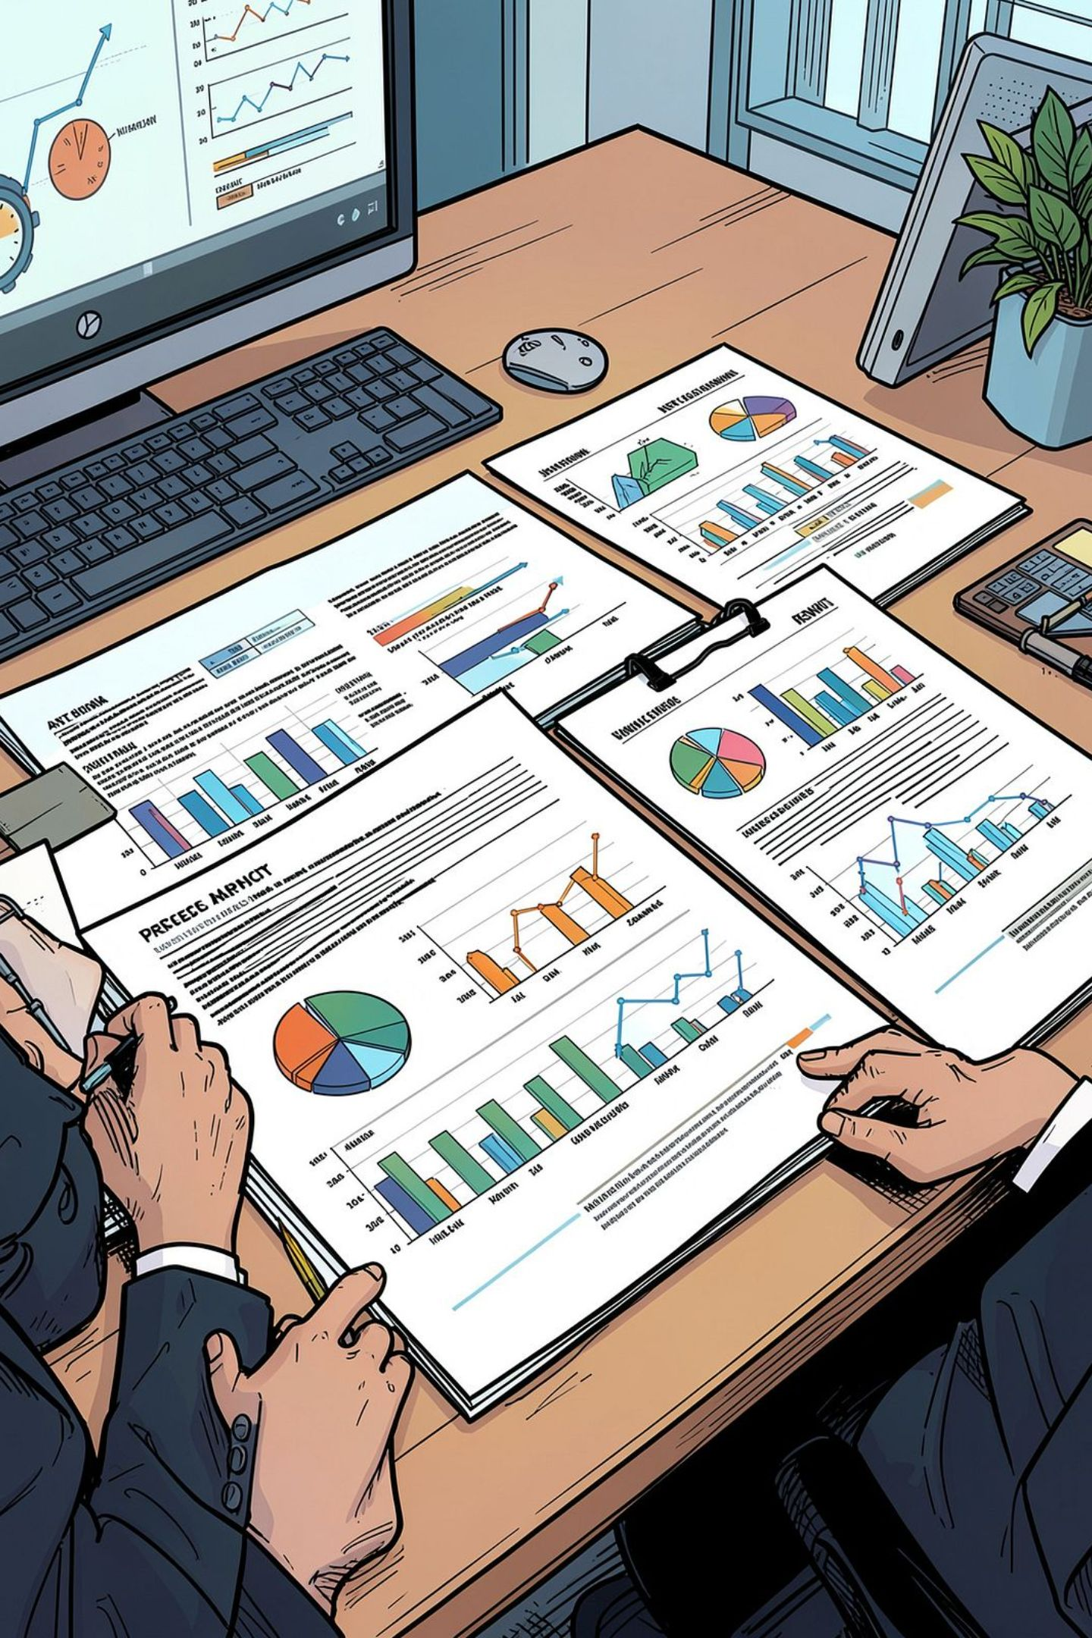



Report Writing
Reports are systematic, well-organized documents communicating information compiled through research and data analysis. They present facts and findings aimed at forming an opinion or recommendation.
Functions of a Report
Judging performance, informing change, fact-finding, identifying causes of problems, suggesting solutions, and supporting decision-making.
What Makes a Good Report
Accurate, objective, complete, well-structured, and at the right level for the reader. Must meet readers' needs, avoid assumptions, and be grammatically concise.
Types of Reports
Academic (detailed, for academicians), Professional (informing and persuading), Formal (complex, may be bound volumes), Technical/Special (industry-specific), and Feasibility (analyzes and recommends a course of action).

Slide 6

Report Structure & Writing Steps
Parts of a Report
Steps to Follow
Title Page — full title, author(s), purpose, institution, date
Executive Summary — highlights purpose, methods, findings, conclusions, recommendations (max 1 page)
Introduction — topic, purpose, and approach
Methodology — research methods used
Results/Findings — data presented (no interpretation)
Discussion — analysis and interpretation
Conclusions — summary deduced from findings
Recommendations — solutions and changes proposed
Appendices — supplementary material
01
Plan
Define purpose, gather and evaluate sources, impose tentative structure.
02
Write
Draft main sections first, then introduction and conclusion.
03
Reference
Cite all sources accurately.
04
Review
Revise, proofread, and ask someone else to check.
05
Final Draft
Write professionally — short sentences, no jargon, KISS principle.
Use double spacing, Times New Roman 12pt font. Tables and figures should be preceded by commentary. Avoid emotional language and double negatives.

Slide 7


Report Formats & Business Plans
Report Formats
Business Plans
A business plan evaluates the feasibility of a new idea objectively. It serves as an operating strategy, a "selling tool," and a financing proposal.
Three key questions:
Memos
Letter Reports
Internal communication; impersonal, objective tone. Includes sender, receiver, date, and subject.
One-page external documents in block format on company letterhead.
Marketing: Is there a market? How much can I sell?
Management: Does the team have required skills?
Financial: Can the business make a profit?
Formal Reports
Semi-Formal Reports
A plan with no plan is a leading cause of business failure.
Methodical structure: title page, cover letter, table of contents, executive summary, body, references.
Shorter version with title page, introduction, body, and references.

Slide 8




Business Plan: Three-Section Structure
Section One: The Business
Section Two: Financial Data
Section Three: Supporting Documents
Written section (10–20 pages) covering: business description, products/services, market analysis, marketing plan, location, competition, management, personnel, and loan/investment application. Use headlines, graphs, and bullets for readability.
Projected Income Statements, Cash Flow Statements, Balance Sheets, Break-Even Analysis, and Sources/Uses of Funds. Base projections on facts and research — forecast 2–4 years, monthly for the first 12.
Historical financials, tax returns, résumés, reference letters, personal financial statements, facilities diagrams, letters of intent, and contracts.
Ways to Ruin Your Plan: Submitting a rough copy, outdated financials, unsubstantiated assumptions, too much "blue sky," lack of financial understanding, vague strategies, no owner equity, unwillingness to guarantee loans, or unrealistic loan terms.

Slide 9








Business Plan: Section One Details
Section One describes the management and marketing aspects of the business. Key subsections:
A. Description of Business
B. Products/Services
Business type, status (start-up/expansion/takeover), form (sole proprietorship, partnership, etc.), products, and customers.
Features, benefits, positioning, and differentiation from competition. Explain why customers will buy from you.
C. Market Analysis
D. Marketing Plan
Market size, growth, your share, industry outlook, and under-served segments. Use research from trade associations, government stats, and competitor observation.
Product, pricing, and promotional strategies. Define target markets, media channels, messaging, cost, and timetable.
E–F. Location & Competition
G–I. Management, Personnel & Investment
Address, ownership/lease terms, and why the location suits the business. Identify largest competitors and how you compare.
Management qualifications, organizational structure, personnel needs, salaries, and total investment required with repayment plan.

Slide 10

Meeting Minutes
Minutes are the official written record of a meeting — authentic documents that can be used in courts and banks. They record attendees, matters discussed, decisions made, and action points.
1. Prepare
3. After Meeting
Gather agenda, previous minutes, discussion documents, and writing materials.
Check with chairperson for accuracy, then circulate to all attendees within the same day.
1
2
3
4
2. During Meeting
4. Disseminate
Record attendees, start time, key discussions, decisions (and how/by whom), and next steps with a DRI assigned.
Send via email with relevant documents attached. Ask a question to ensure participants review the minutes.
What to Include: Meeting title, date, time, venue, participant names, agenda items, main points discussed, decisions made, action tasks with responsible persons and deadlines, and future decisions. Keep minutes clean, professional, and concise — not a full transcript.

