Slide 1
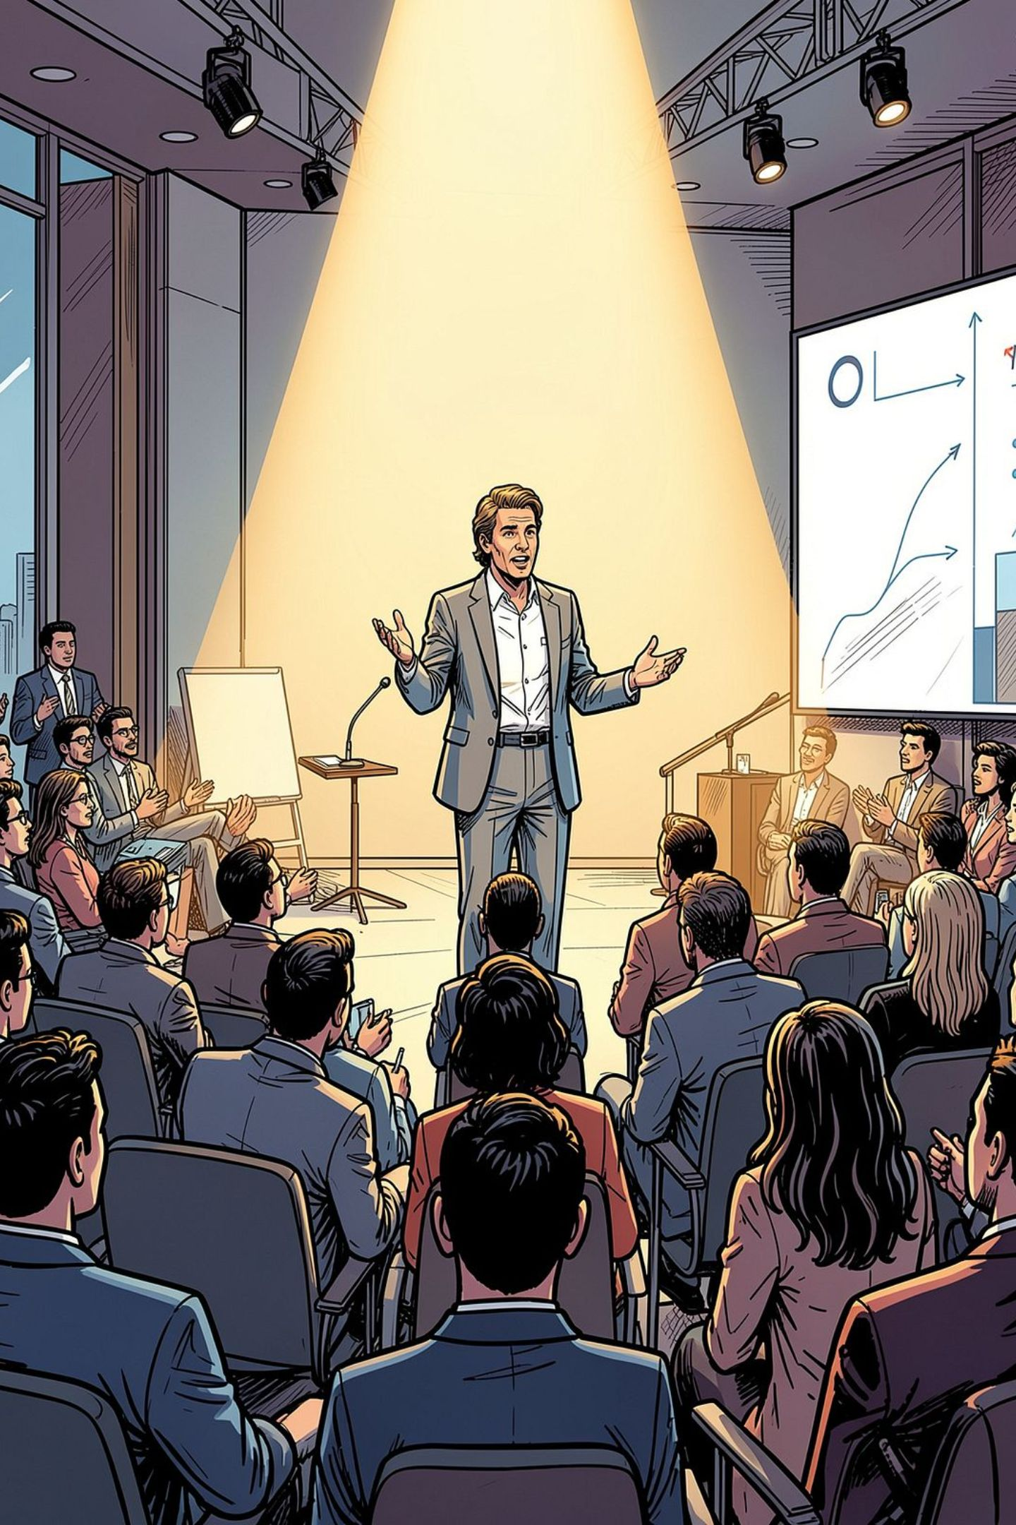
Presentation Skills
Chapter Six — Somaville University, Faculty of Computer Science
A presentation is a means of communication adapted to various speaking situations — from addressing a group or meeting a team, to making a speech or presenting in a video conference. Effective presentations require clear structure, engaging delivery, and careful preparation.

Slide 2
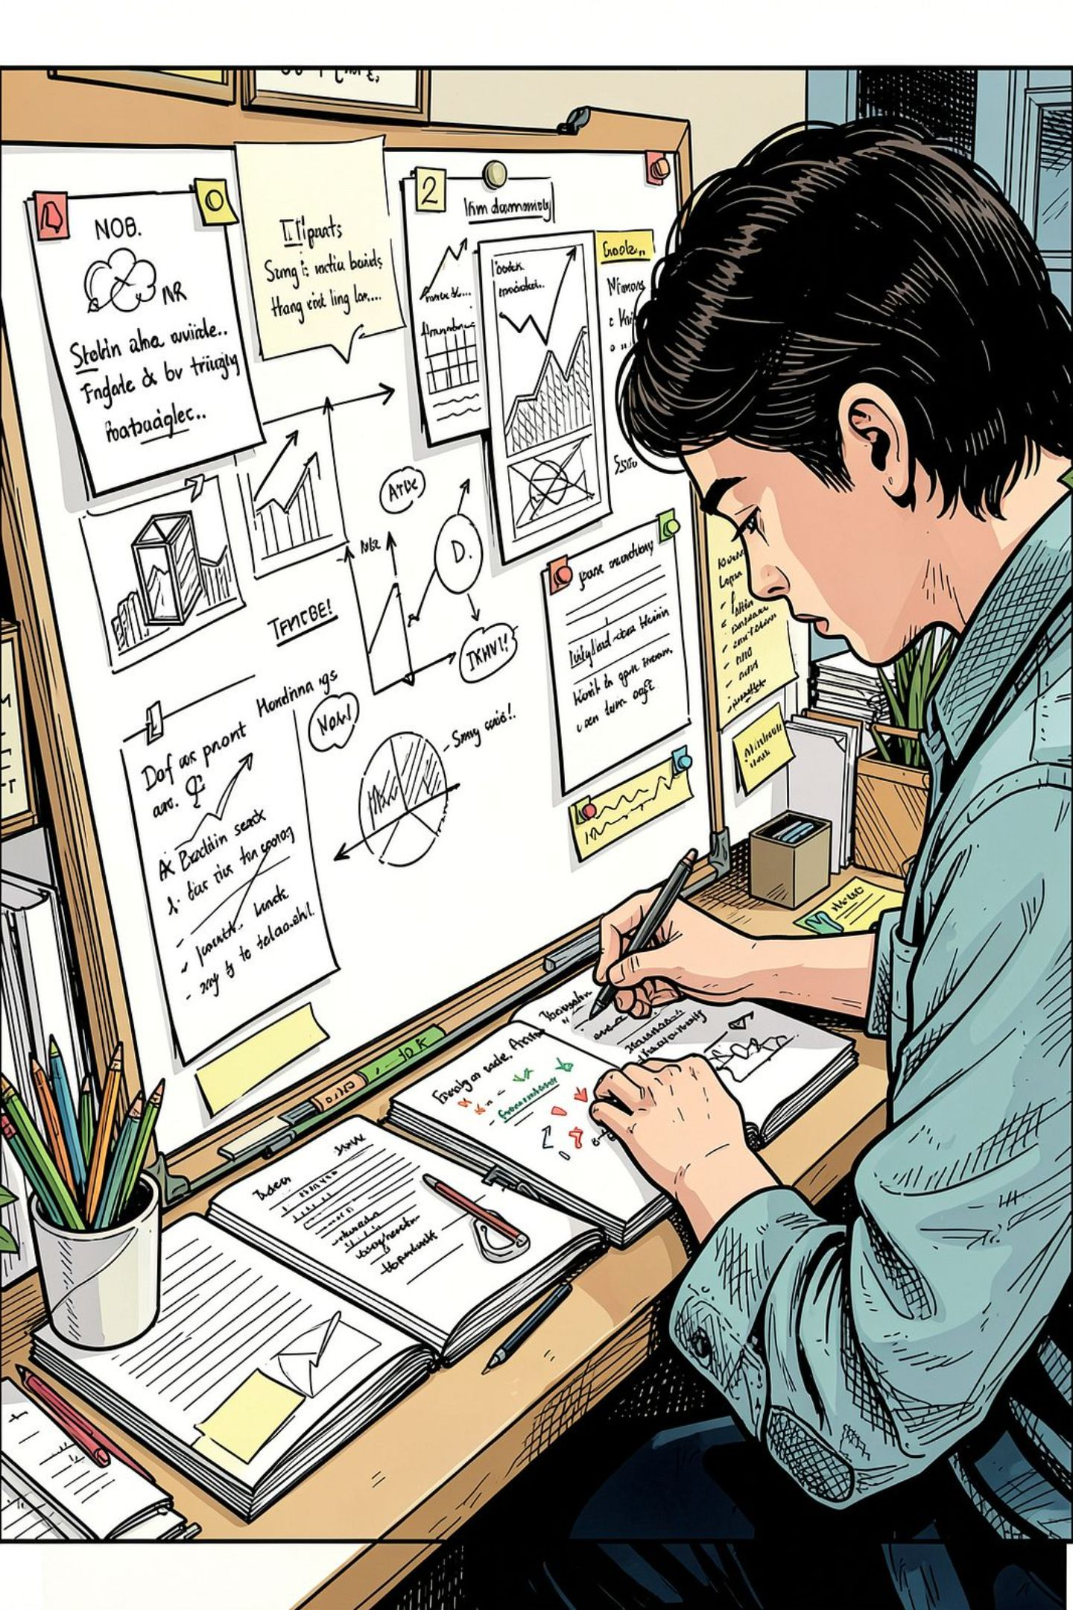
What Are Presentation Skills?
Presentation skills encompass everything needed to deliver effective, engaging presentations to a variety of audiences. These skills cover structure, slide design, tone of voice, and body language. To be an effective presenter, step-by-step preparation and the method of presenting information should be carefully considered.
Structure
Organize your content clearly with a defined introduction, body, and conclusion.
Visual Design
Design slides and visual aids that support your message without overwhelming the audience.
Voice & Tone
Use appropriate pacing, volume, and vocal variety to maintain engagement.
Body Language
Convey confidence through posture, eye contact, and purposeful gestures.

Slide 3
Planning Your Presentation
It can be helpful to plan your presentation in terms of key steps. Clear planning determines your content and direction.
01
02
03
Set Your Objective
Decide Your Purpose
Understand Your Audience
Define your purpose in one sentence: "As a result of my presentation, my audience will be able to…" For example: "Explain the methods of preventing HIV/AIDS."
Determine whether your talk aims to inform, persuade, motivate, or change things. What do you want your audience to do as a result?
Know the audience's size, knowledge level, expectations, and any preconceptions or misconceptions you need to address.
04
05
Know Your Setting
Write Your Outline
Find out what equipment and audiovisual aids are available. Check the room size and seating arrangements.
Write the central theme, identify main points, supporting information, and estimate how much time you will need.

Slide 4
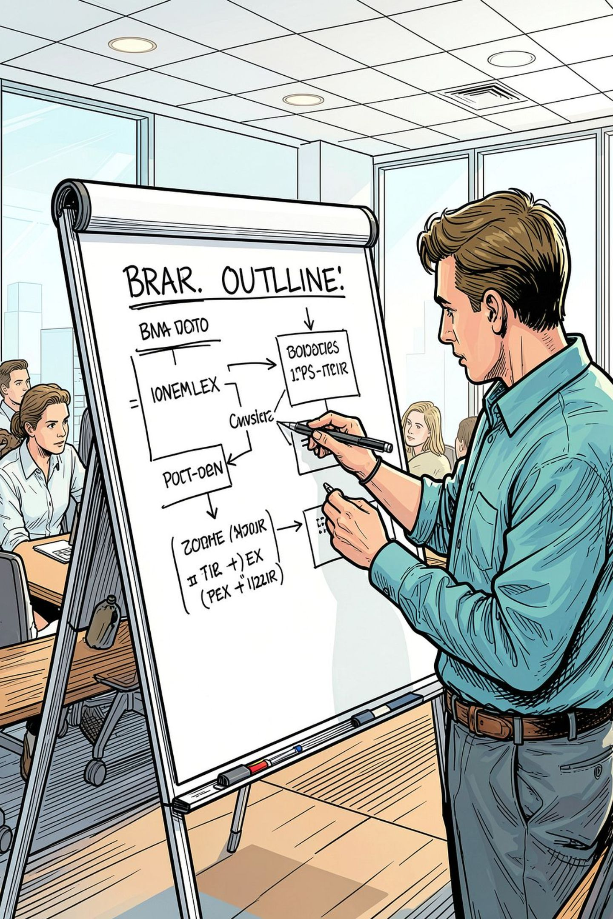



Structuring Your Presentation
The structure of a presentation should have an introduction, body, and conclusion — clear to both you and your audience. Develop visual aids such as flipcharts, whiteboards, or projectors to clarify important points, but avoid using too many slides. Prepare delivery notes according to your structured outline.
Introduction
Grab attention and set the scene
Body
Support your argument with key points
Conclusion
Summarize, recommend, and close strong

Slide 5
The Introduction
Through the introduction, you should grab your audience's attention and set the scene. Your theme should be made clear from the start. Start the audience thinking about the subject matter by stating your main objective, and briefly explain how you plan to proceed.
Ways to Grab Attention
Key Principles
Ask a rhetorical or intriguing question
Provide a relevant and interesting fact
Give an anecdote
Outline the valuable information the audience will gain
Tell them why they need to know this
Give a quote or make a dramatic prediction
Your theme should be clear from the start. State your main objective and briefly explain how you plan to proceed with the talk. This helps orient the audience and builds anticipation for what follows.

Slide 6
The Main Body & Conclusion
The Main Body
The Conclusion
Select main points that support your argument, but only include as much detail as your audience needs — people will not remember too many points. Organize points into a logical sequence: chronological, problem-solution, or simple-complex. Explain and build your points using supporting information and evidence.
Do not end suddenly — signal that you are closing with phrases like "In conclusion." Research shows we remember the opening and closing of a presentation most. Try to end on a strong note:
Summarize main points
Draw out the conclusion and its importance
Make recommendations or ask for action
Ask for questions or feedback
Thank the group for their time and attention

Slide 7

Four Types of Delivery
DeVito (1990) outlines four main delivery methods. Choose the approach — or combination — that is least stressful for you.
1
2
Impromptu
Extemporaneous
Speaking with no prior planning. Write key points on a card, stay relaxed and conversational, and don't panic — the audience knows you had little time.
Carefully prepared but delivered with minimal notes or slides. Use cue cards summarizing main points. Often given with under 30 minutes of preparation.
3
4
Memorized
Reading from Manuscript
Learning and repeating a manuscript. Difficult for longer talks, but memorizing the first few lines helps you get started confidently.
Speaking from a prepared text. Use it as a guide rather than reading word-for-word to avoid sounding stilted. Rehearse to remember key points.

Slide 8






Techniques of Effective Delivery
Hargie et al (2004) outline key features of effective delivery. Apply these techniques to keep your audience engaged and your message clear.
Language & Pace
Visual Aids
Use appropriate language and avoid jargon. Speak at a suitable pace — not too fast, not too slow. Consider placing someone in the audience to signal if your speed drifts.
Use visual aids without placing them center stage — even the best are only aids to assist the speaker. Vary your delivery with graphs, slides, or video breaks.
Signposts & Links
Emphasize Key Points
Use sub-summaries and transitional pauses to briefly recap material. Explain how each "chunk" links to what comes next, increasing coherence.
Emphasize verbally (listing, repeating), non-verbally (gestures, posture), and vocally (volume, speed, tone). Be concrete and precise rather than vague.
Examples & Fluency
Be Natural
Include carefully chosen examples as a bridge between what the listener knows and new material. Avoid fillers like "umms" and "ahhhs" — they are highly distracting.
Seem natural, not contrived — this takes practice. Avoid distractions like pacing, playing with a pen, or overusing stock phrases. Gain control of body language.

Slide 9

Body Language & Managing Anxiety
Remember the importance of non-verbal communication! Your manner of speech and physical presence are as important as your words.
Effective Body Language
Managing Presentation Anxiety
Behave enthusiastically and maintain eye contact
Smile and act "as if" you are confident (even if you're not)
Ensure your voice reaches the furthest listener
Speak clearly at a conversational speed
Vary tone, pitch, and rate to communicate enthusiasm
Pause before key points; stress key words with tone changes
Accept that feeling nervous is perfectly normal
Prepare well — preparation is the best antidote to anxiety
Be realistic — challenge negative thoughts; worst-case scenarios are highly improbable
Use relaxation exercises such as deep breathing
Behave "as if" confident — rehearse how you will stand, set out notes, and change slides

Slide 10





Key Takeaways
Effective presentations combine careful planning, clear structure, confident delivery, and strong non-verbal communication.
Plan with Purpose
Structure Clearly
Set a clear objective, know your audience, and understand your setting before writing a single slide.
Use a strong introduction, a focused body with logical sequencing, and a memorable conclusion.
Deliver Confidently
Master Non-Verbals
Choose the delivery method that suits you. Practice, vary your voice, and use visual aids wisely.
Eye contact, posture, tone, and pace all communicate confidence and keep your audience engaged.
Remember: Research shows audiences remember the opening and closing of a presentation most — make both count.

