Slide 1

Communication Skills
Communication is a key element in any human activity — a learned skill that most people take for granted. While we are born with the physical ability to talk, not everyone communicates well without making special efforts to develop and refine this skill. This chapter explores what communication is, its forms, characteristics, barriers, and how to become an effective communicator.
CHAPTER ONE
SOMAVILLE UNIVERSITY, FACULTY OF COMPUTER SCIENCE

Slide 2
What Is Communication?
Definition
Basic Steps
Communication is derived from the Latin communis or communīcōre, meaning "to make common" or "to share." It is the act of conveying intended meaning to another person through mutually understood signs and language — the art of transmitting information, ideas, and attitudes from one person to another.
01
Forming communicative intent
02
Message composition & encoding
03
Transmission of signal
04
Reception, decoding & interpretation
Communication is not what is said — verbally or non-verbally — but what is understood.

Slide 3

Characteristics of Communication
Two-Way Process
Communication involves both receiving (listening) and asserting/expressing (sending). Participants exchange information and create shared meaning.
Dynamic & Complex
It is ever-changing depending on the variables at play. It involves sharing information using a code and can be verbal, non-verbal, or visual.
Irreversible
Once something has been communicated, it cannot be recalled. Communication can also be accidental, especially in non-verbal contexts.
Requires Elements
Every communication act must have: a source, receiver, channel, message, noise, and feedback. It occurs between people and sometimes animals.

Slide 4

Functions & Forms of Communication
Why We Communicate
Verbal Communication
To inform, educate, and entertain
All communication is either verbal or non-verbal, and both can be vocal or non-vocal. Verbal communication uses speech to exchange information — in meetings, interviews, conferences, phone calls, and face-to-face conversations.
To influence others and change behavior
Vocal verbal: Spoken language
Non-vocal verbal: Written communication, sign language, finger spelling, Braille
To express thoughts and emotions
To establish relationships and solve problems
To motivate, give directions, and build confidence

Slide 5



Paralanguage & Non-Verbal Communication
Paralanguage
Non-Verbal Communication
Paralinguistic features are vocal signals beyond the basic verbal message — they add emphasis and convey meaning beyond words. They include pitch, rate, voice quality, amplitude, laughter, prosody (rhythm, stress, intonation). These features are often culturally coded and operate subconsciously, alerting listeners how to interpret the message.
Non-verbal communication uses gestures, body language, facial expressions, touch, smell, and distance. The three elements of face-to-face communication account for meaning as follows:
7%
Words
38%
Tone of Voice
55%
Body Language

Slide 6
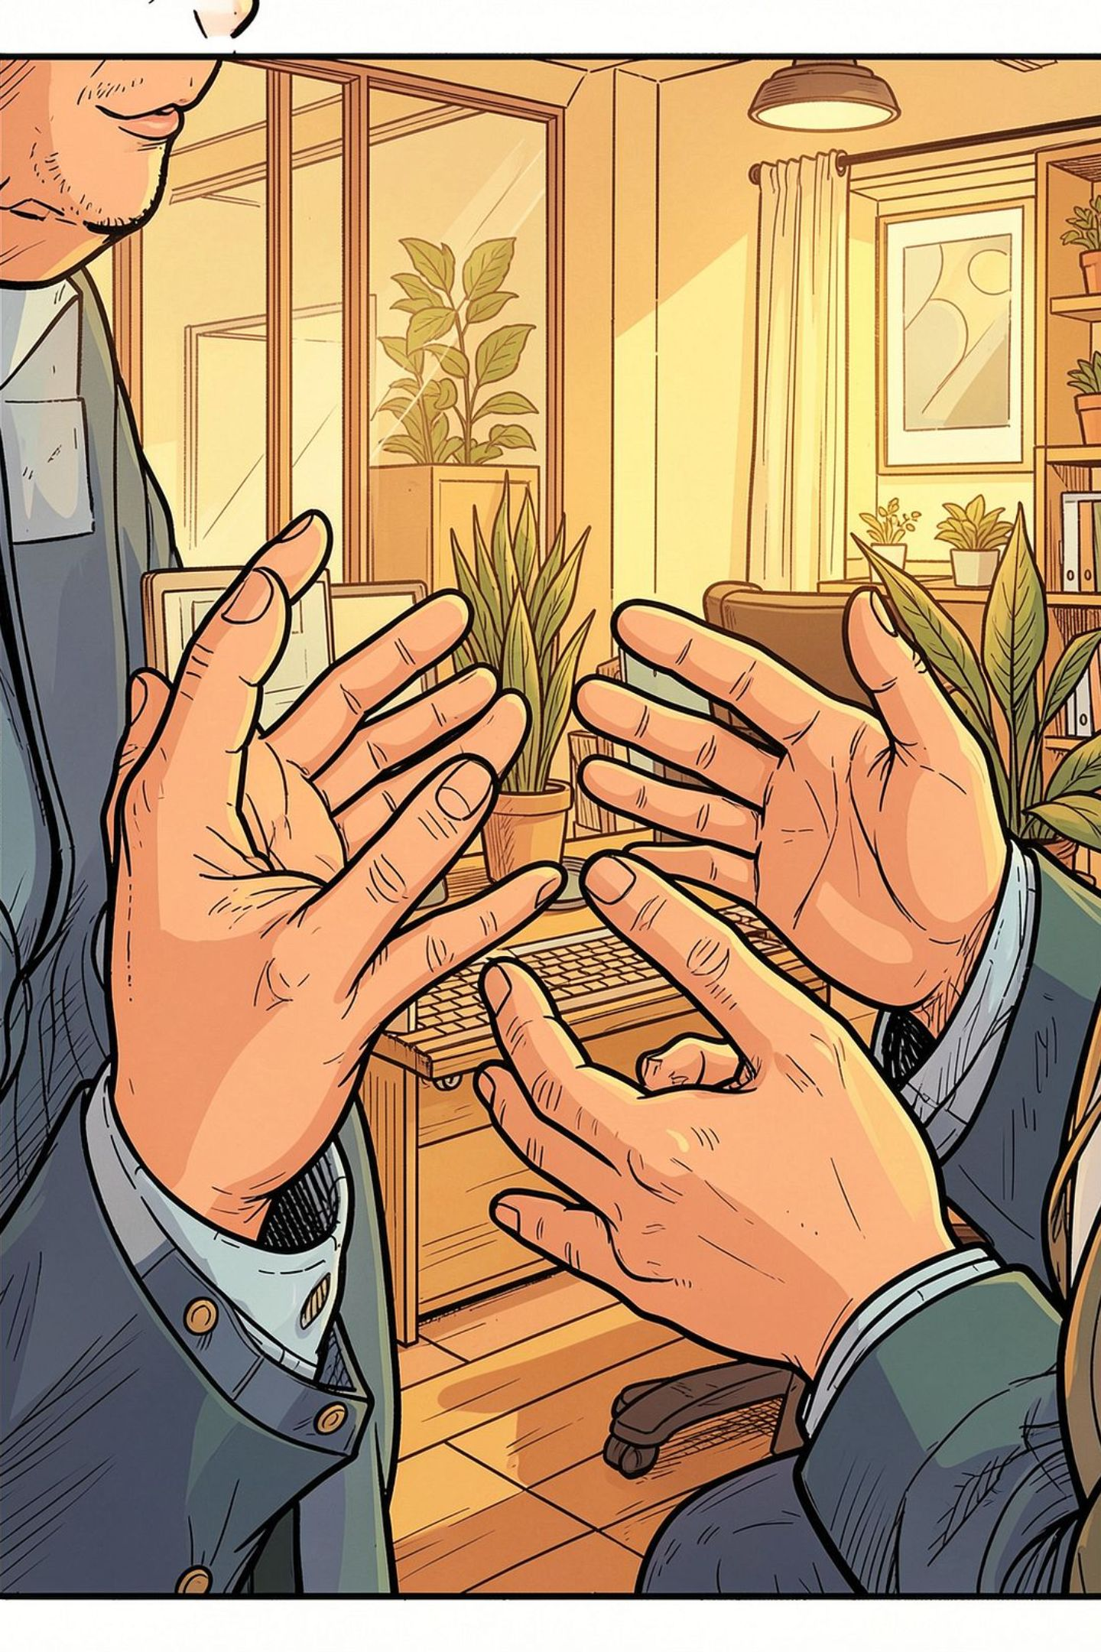



Body Language & Levels of Communication
Hands & Gestures
People rub arms together, keep arms closed, or clench fists — all revealing inner thoughts involuntarily. Clenched hands can signal confidence, but if too tight, frustration or hostility.
Eye Contact & Facial Expressions
Facial expressions are the most observable gestures. Eye contact establishes real communication. Downcast eyes signal being shut out; engaged eyes with a slight smile indicate consideration of a proposal.
Levels of Communication
Communication occurs at five levels: Intrapersonal (within a person), Interpersonal (face-to-face), Group, Mass, and Inter-country/Development communication.

Slide 7





Barriers to Communication
Barriers are factors that contribute to total or partial failure of communication. They are multidimensional and can lead to misunderstanding and confusion.
Physiological
Ill health, poor eyesight, or hearing difficulties. Best handled by developing a positive perception.
Physical
Office doors, barrier screens, distance, and separate working areas. Proximity is key to building cohesive teams.
Cultural & Language
Culture prescribes behavior; language barriers arise from jargon and unfamiliar expressions. In a global setting, speaking in another's language is the greatest compliment.
Psychological
Three types: Perceptual (we see the world differently), Emotional (fear, mistrust, suspicion), and Experiential (lack of experience alters interpretation).
Stereotypes & Authority
Stereotypes are over-generalized assumptions about groups based on visible traits. They distort reality and create a "halo effect." Authority barriers are often neglected but equally impactful.

Slide 8
Elements & Models of Communication
The 5 Elements
Three Communication Models
1
Source/Sender
Linear (1948)
Interactive (1955)
The originating point who encodes thoughts into words.
One-way: speaker speaks, listener listens. Flaw: ignores feedback.
Sender and receiver take turns; feedback is verbal or non-verbal.
2
Message
What the receiver perceives — not necessarily what the sender intended.
Transactional
3
Channel
Both parties simultaneously send and receive; accounts for noise, context, and continuous change.
The medium: email, face-to-face, phone, letter, etc.
4
Receiver
Decodes and interprets the message using cultural and contextual background.
5
Feedback
The receiver's response — without it, communication breaks down.
Noise (internal or external) competes for attention at every stage.

Slide 9
Effective Communication & The 7 Cs
Effective communication produces results — the intended message is delivered clearly and desired feedback is achieved. It requires effort from both sender and receiver. Miscommunication is avoidable but, if undetected, causes confusion and wastes opportunities.
Clear
Concise
Concrete
Minimize ideas per sentence; be direct about your purpose.
Stick to the point — three sentences instead of six.
Use vivid facts and details; give your audience a clear picture.
Correct
Coherent
Complete
Fits your audience and is error-free.
All points are connected, logical, and consistent in tone.
Include everything needed to inform and enable action.
Courteous
Friendly, open, honest — empathetic to the receiver's viewpoint.

Slide 10


How to Be a Good Communicator
Key Skills
Effective Communication Skills Include
Express ideas clearly
Eye contact & visible mouth
Body language awareness
Give and accept feedback openly
Use of silence & smiling
Checking for understanding
Respect attitudes, opinions, and cultures
Summarizing & asking questions
Encouragement to continue
Give full attention; encourage others to talk
Be empathetic and build trust
Communication is successful only when both sender and receiver reach a common understanding as a result of the process.
Follow through on commitments

