Slide 1

Essential Nutrition Actions (ENA)
An action-oriented approach to nutrition that, if implemented, is estimated to decrease child mortality by 25%. The seven essential actions and six contact points should be included in the curricula of all health science students.
UNIT TWELVE
NUTRITION

Slide 2
The Seven Essential Actions at a Glance
ENA organizes nutrition support into seven focused action areas, each targeting a specific nutritional challenge across the lifecycle.
01
02
03
Promotion of Breastfeeding
Appropriate Complementary Feeding
Feeding of the Sick Child
Optimal initiation, exclusivity, and technique
Increase feeding during and after illness
Right foods at the right time from 6 months
04
05
06
Women's Nutrition
Control of Vitamin A Deficiency
Control of Anaemia
Support during pregnancy and lactation
Supplementation and food-based strategies
Iron, de-worming, and malaria control
07
Control of Iodine Deficiency Disorders
Iodized salt for all families

Slide 3
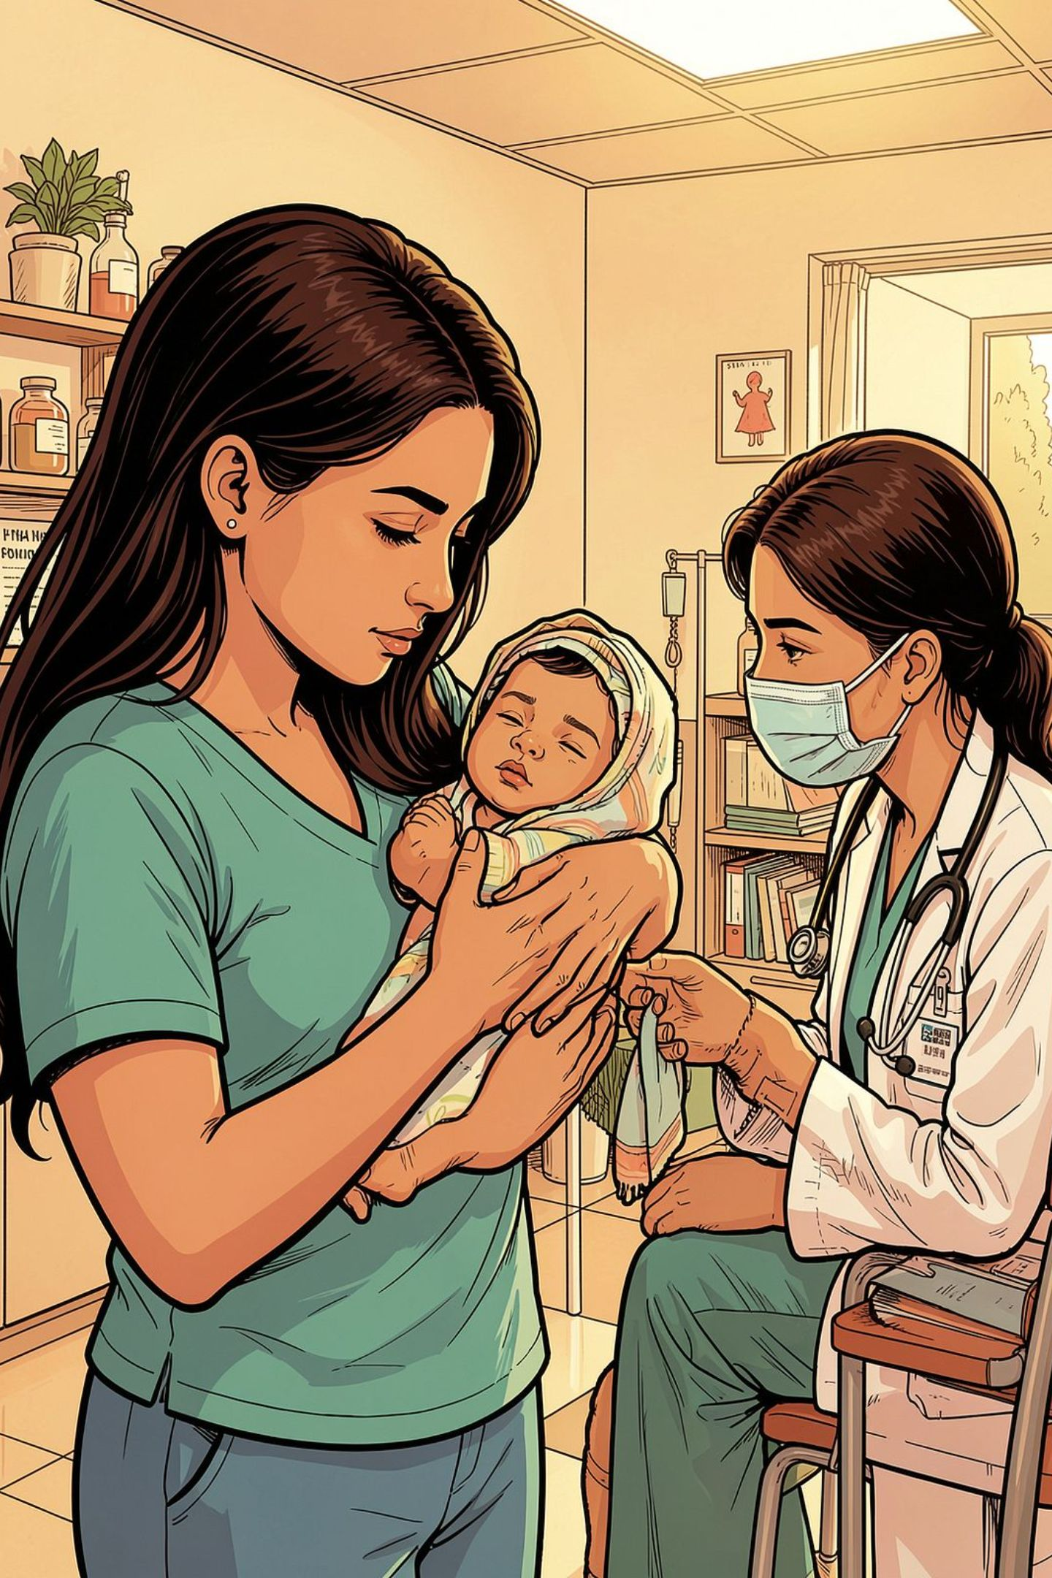


Action 1: Promotion of Breastfeeding
Optimal breastfeeding alone is estimated to decrease child mortality by 13%.
Timely Initiation
Begin breastfeeding within 1 hour of birth
Exclusive Breastfeeding
Exclusive until six months — no other foods or liquids
Frequency
Breastfeed day and night at least 10 times
Technique
Correct positioning and attachment; empty one breast before switching to the other

Slide 4
Actions 2 & 3: Complementary Feeding & Feeding the Sick Child
Appropriate Complementary Feeding
Feeding of the Sick Child
Introduce complementary foods at 6 months
Continue breastfeeding until 24 months and beyond
Increase number of feedings with age
Increase density, quantity, and variety with age
Responsive feeding practices
Ensure good hygiene — clean water, food, and utensils
Illness increases nutritional demands. Key actions include:
Increase breastfeeding during and after illness
Increase complementary feeding during and after illness
Provide appropriate therapeutic feeding as needed

Slide 5

Actions 4 & 5: Women's Nutrition & Vitamin A Control
Women's Nutrition
Control of Vitamin A Deficiency
During pregnancy and lactation:
Estimated decrease of child mortality: 2%
Increase feeding frequency and quality
Iron/Folic Acid supplementation
Treatment and prevention of malaria
De-worming during pregnancy
Vitamin A capsule after delivery
Promote breastfeeding as a source of Vitamin A
Encourage Vitamin A-rich foods
Maternal supplementation
Child supplementation
Food fortification

Slide 6
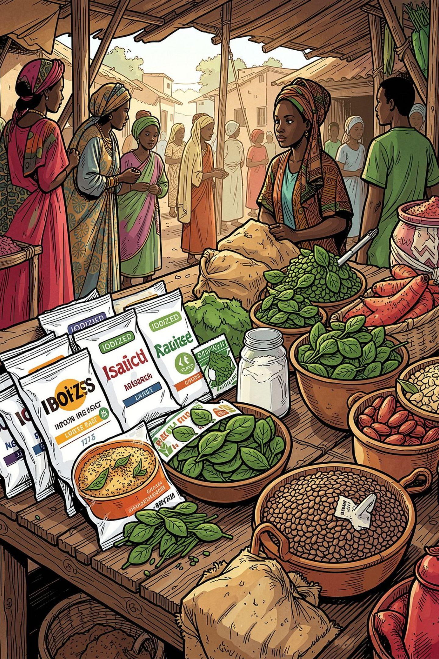
Actions 6 & 7: Anaemia & Iodine Deficiency Control
Control of Anaemia
Supplementation of women and children (IMCI)
De-worming for pregnant women and children — twice per year
Malaria control
Promote iron-rich foods
Food fortification
Control of Iodine Deficiency Disorders
The key message is straightforward: ensure access and consumption of iodized salt by all families. Iodized salt is the primary, cost-effective intervention to prevent iodine deficiency disorders across populations.

Slide 7
Six Critical Contact Points in the Lifecycle
ENA expands nutrition coverage through six key contact points within the health sector.
Antenatal Care
Postnatal & FP
Well Child & GMP
TT, Iron/Folic Acid, de-worming, maternal diet, EBF counseling, safe delivery, iodized salt
EBF, diet, Iron/Folic Acid, FP, STI prevention, child vaccination
Monitor growth, counsel on feeding, iodized salt, complete vaccination, Vitamin A/de-worming
1
2
3
4
5
6
Delivery
Immunizations
Sick Child
Safe delivery, EBF initiation, Vitamin A, Iron/Folic Acid, diet, FP, STI, referral
Vaccination, Vitamin A, de-worming, assess/treat infant anemia, FP, STI, referral
Monitor growth, assess/treat per IMCI, counsel on feeding, treat anemia, Vitamin A, immunization/de-worming

Slide 8





Integrating ENA Within the Health Sector
ENA must be integrated into existing health programs to maximize reach and impact.
Child Survival
Reproductive Health
National Immunization Days
EPI+
Community IMCI
Health facility IMCI
Reproductive Health programs
Women's Nutrition
Lactational Amenorrhea Method
Polio campaigns
Measles campaigns
Nutrition Programs
Infectious Disease Control
Positive deviance
Community Growth Monitoring & Promotion (GMP)
Malaria
Tuberculosis
HIV/AIDS (PMTCT)

Slide 9




Integrating ENA Outside the Health Sector
ENA's reach extends beyond clinics — integration into other sectors is essential for population-wide impact.
Schools & Adolescents
Sanitation & Public Health
1
Adolescent nutrition, de-worming, iron supplementation, school lunch programs
1
Clean water, sanitation, public health education, prevention of diarrhea, malaria, ARI
Agriculture
Micro-Credit & Income
2
Food diversification, food security, women farmers' clubs
2
Income generation and nutrition education for families
Emergency Response
3
Women-to-women support during crises

Slide 10
The Stakes: Why ENA Matters
The most visible evidence of good nutrition is a taller, stronger, healthier child who learns more in school and becomes a productive, happy adult who participates in society.
A Critical Reality
The Majority Are Mild or Moderate
Malnutrition does not need to be severe to pose a threat to survival. Worldwide, fewer than 20% of deaths associated with childhood malnutrition involve severe malnutrition.
More than 80% of malnutrition-related child deaths involve only mild or moderate malnutrition — cases that are preventable through the Essential Nutrition Actions approach.
25%
13%
Estimated Child Mortality Reduction
From Optimal Breastfeeding Alone
If ENA approach is fully implemented
Single most impactful action
2%
80%
From Vitamin A Control
Deaths from Mild/Moderate Malnutrition
Supplementation and food-based strategies
Preventable through ENA

